Slide 1


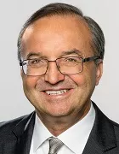
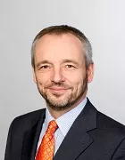
Enhancing Seismic Safety in Munich's Geothermal Energy Sector: Data-driven Model Updating for Building Vibrations under Induced Seismicity
MDSI General Assembly, October 24, 2024
M.Sc. Wei-Teng, Kao
Technical University of Munich
TUM School of Engineering and Design
Chair of Structural Mechanics
Munich, 16.09.2024
M.Sc. Wei-Teng Kao
TUM Chair of Structural Mechanic
Technical University of Munich Arcisstr. 21 80333 Munich
ge32gak@mytum.de
Prof. Dr. Gerhard Müller
TUM Chair of Structural Mechanic
Technical University of Munich Arcisstr. 21 80333 Munich
gerhard.mueller@tum.de
Prof. Dr. Wolfgang Wall
TUM of Numerical Mechanics
Technical University of Munich
Boltzmannstr. 15 85748 Garching b.
wolfgang.a.wall@tum.de
MDSI General Assembly, October 24, 2024

Slide 2
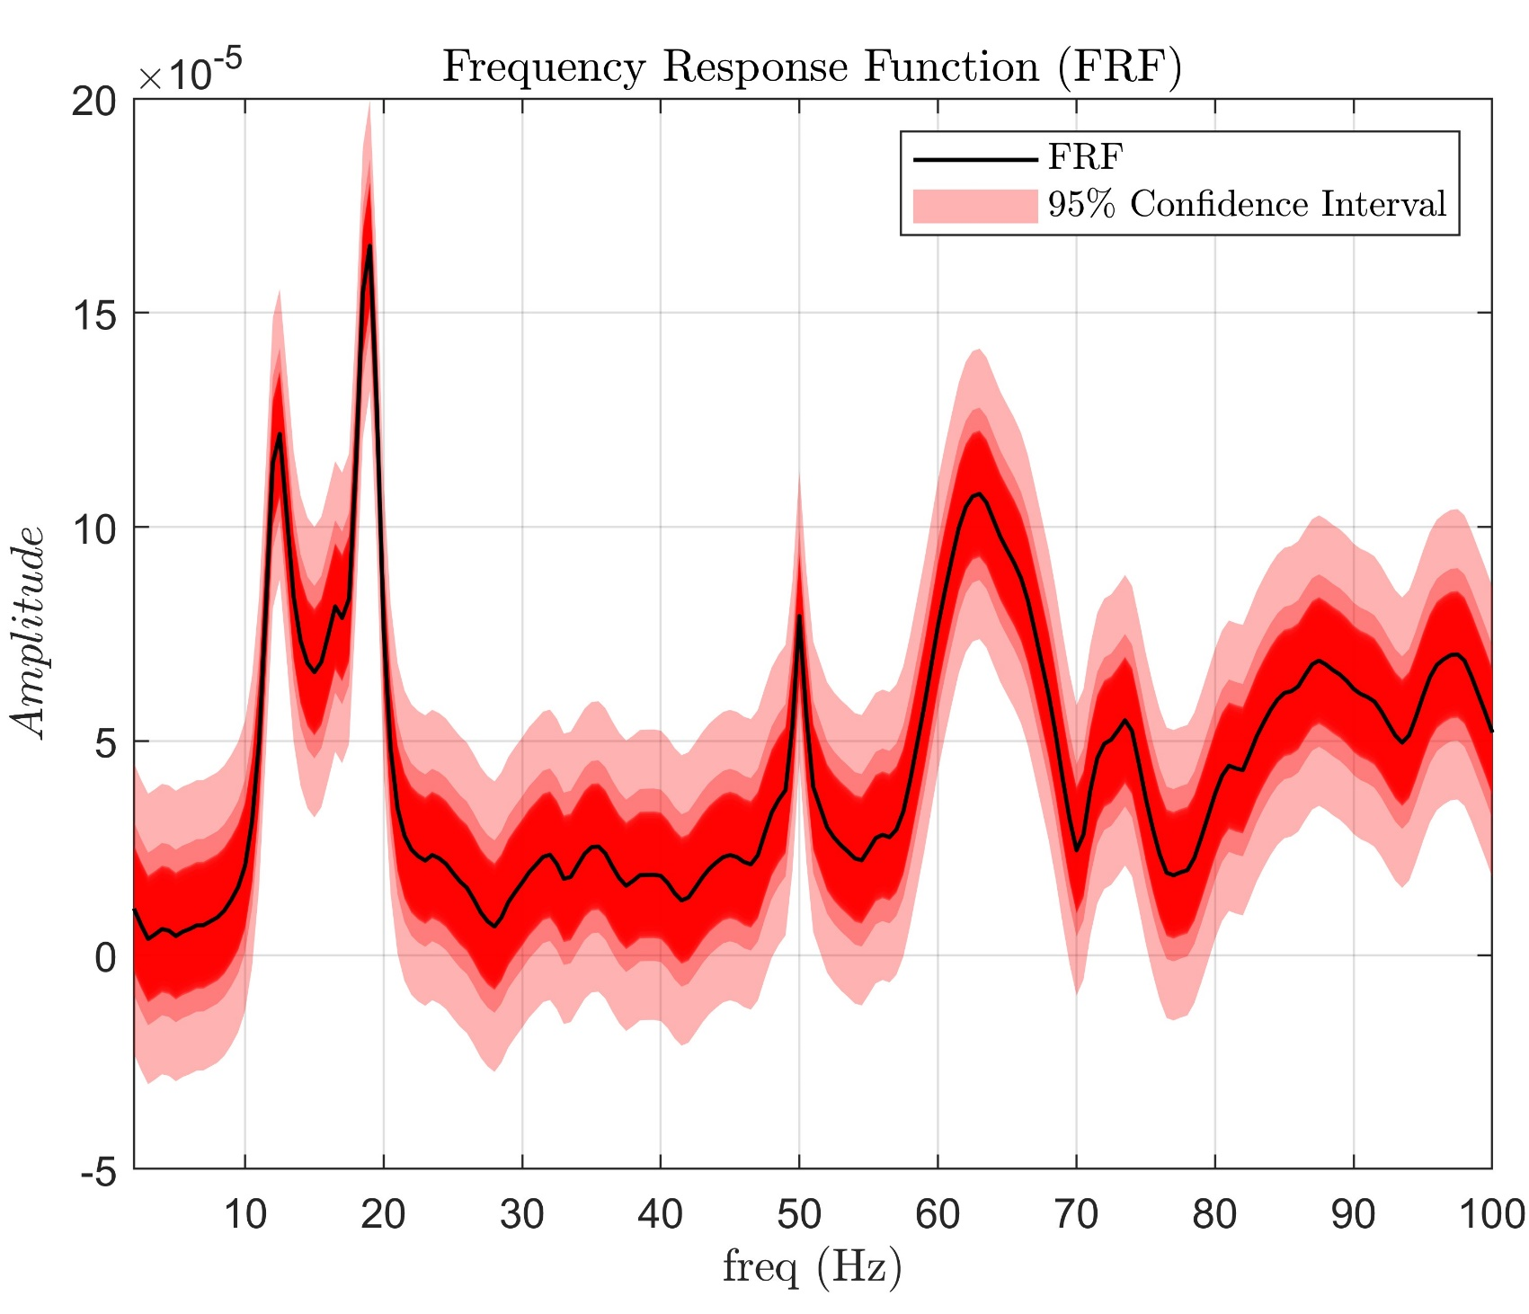
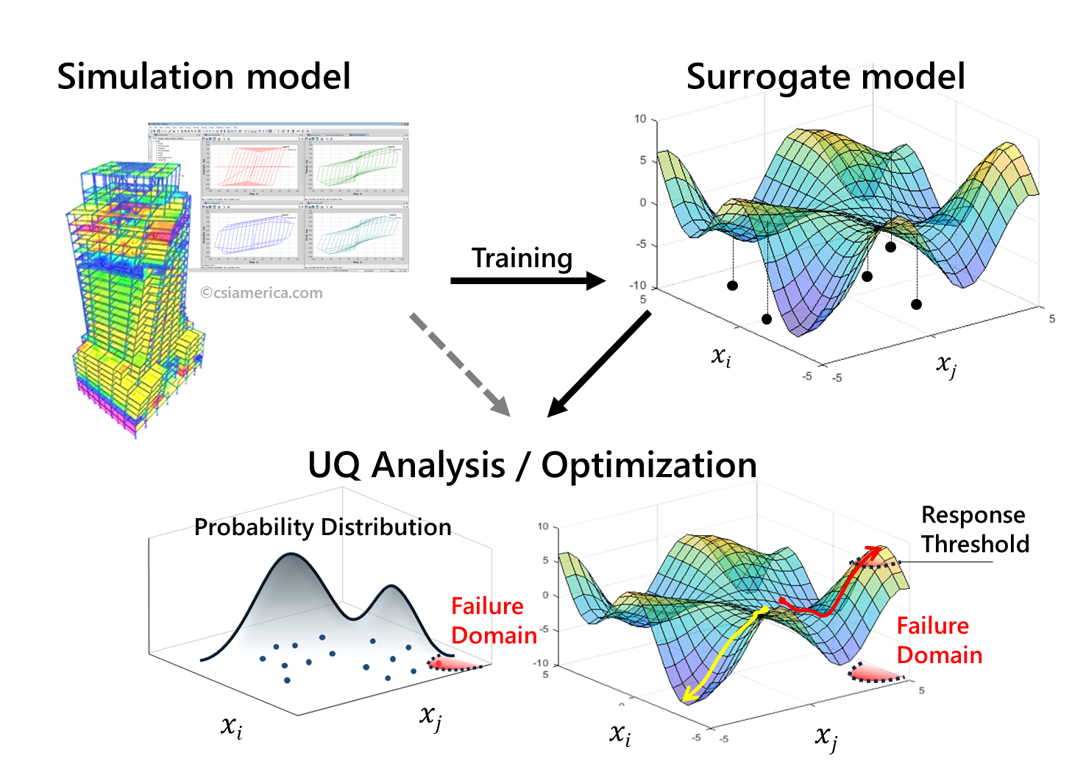
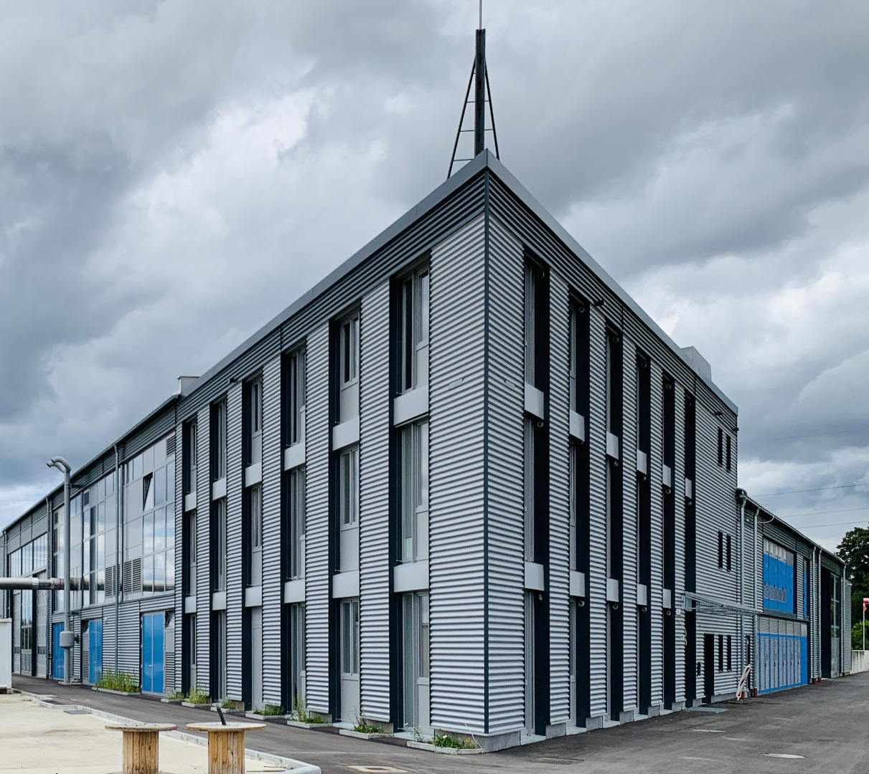
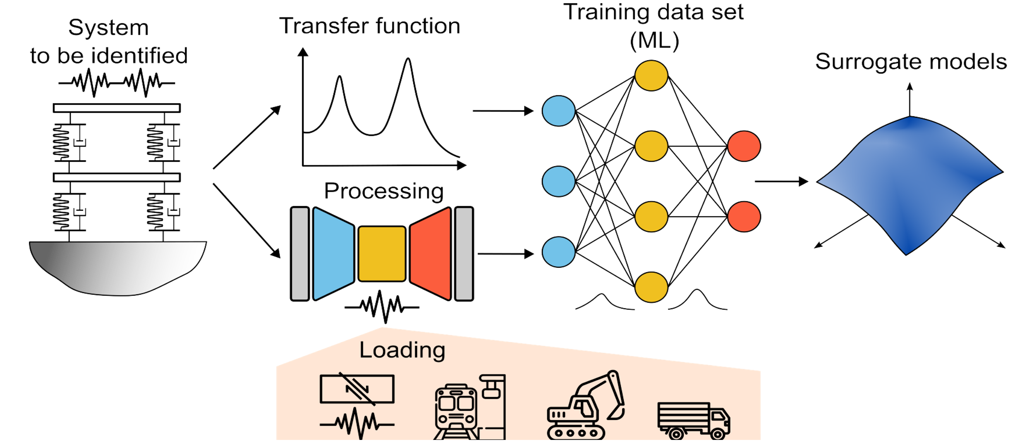
Enhancing Seismic Safety in Munich's Geothermal Energy Sector: Data-driven Model Updating for Building Vibrations under Induced Seismicity
Wei-Teng, Kao
Prof. Dr. Gerhard Müller (Chair of Structural Mechanics), Prof. Dr. Wolfgang Wall (Chair of Numerical Mechanics)
M.Sc. Wei-Teng Kao
TUM Chair of Structural Mechanic
Technical University of Munich Arcisstr. 21 80333 Munich
ge32gak@mytum.de
Prof. Dr. Gerhard Müller
TUM Chair of Structural Mechanic
Technical University of Munich Arcisstr. 21 80333 Munich
gerhard.mueller@tum.de
Prof. Dr. Wolfgang Wall
TUM of Numerical Mechanics
Technical University of Munich
Boltzmannstr. 15 85748 Garching b.
wolfgang.a.wall@tum.de
MDSI General Assembly, October 24, 2024

Slide 3
Enhancing Seismic Safety in Munich's Geothermal Energy Sector: Data-driven Model Updating for Building Vibrations under Induced Seismicity
Wei-Teng, Kao
Prof. Dr. Gerhard Müller (Chair of Structural Mechanics), Prof. Dr. Wolfgang Wall (Chair of Numerical Mechanics)
Menhir Database & Experiment (12.03.2024)
More than 1000 recorded data stored in the Menhir database from long-term monitoring (over one year) for the 1st floor -> Output only.
38 recorded data that the sensors on all three floors are activated simultaneously.
-> Input = Ground floor/ Output.
13 recorded data by the Experimental hammer testing (12.03.2024) -> Input/Output.
M.Sc. Wei-Teng Kao
TUM Chair of Structural Mechanic
Technical University of Munich Arcisstr. 21 80333 Munich
ge32gak@mytum.de
Prof. Dr. Gerhard Müller
TUM Chair of Structural Mechanic
Technical University of Munich Arcisstr. 21 80333 Munich
gerhard.mueller@tum.de
Prof. Dr. Wolfgang Wall
TUM of Numerical Mechanics
Technical University of Munich
Boltzmannstr. 15 85748 Garching b.
wolfgang.a.wall@tum.de
MDSI General Assembly, October 24, 2024

Slide 4
Enhancing Seismic Safety in Munich's Geothermal Energy Sector: Data-driven Model Updating for Building Vibrations under Induced Seismicity
Wei-Teng, Kao
Prof. Dr. Gerhard Müller (Chair of Structural Mechanics), Prof. Dr. Wolfgang Wall (Chair of Numerical Mechanics)
Clustering
System Identification
Forming the FRF
Parameterized the FRFs by rational-based polynomial or other technique
Introduce uncertainty.
M.Sc. Wei-Teng Kao
TUM Chair of Structural Mechanic
Technical University of Munich Arcisstr. 21 80333 Munich
ge32gak@mytum.de
Prof. Dr. Gerhard Müller
TUM Chair of Structural Mechanic
Technical University of Munich Arcisstr. 21 80333 Munich
gerhard.mueller@tum.de
Prof. Dr. Wolfgang Wall
TUM of Numerical Mechanics
Technical University of Munich
Boltzmannstr. 15 85748 Garching b.
wolfgang.a.wall@tum.de
MDSI General Assembly, October 24, 2024

Slide 5
Enhancing Seismic Safety in Munich's Geothermal Energy Sector: Data-driven Model Updating for Building Vibrations under Induced Seismicity
Wei-Teng, Kao
Prof. Dr. Gerhard Müller (Chair of Structural Mechanics), Prof. Dr. Wolfgang Wall (Chair of Numerical Mechanics)
Infer the possible excitation types once FRFs are built.
Introduce the new excitation type, geothermal-induced earthquake, for further simulation.
More than 500 recorded earthquakes are stored in the Database in Insheim area.
M.Sc. Wei-Teng Kao
TUM Chair of Structural Mechanic
Technical University of Munich Arcisstr. 21 80333 Munich
ge32gak@mytum.de
Prof. Dr. Gerhard Müller
TUM Chair of Structural Mechanic
Technical University of Munich Arcisstr. 21 80333 Munich
gerhard.mueller@tum.de
Prof. Dr. Wolfgang Wall
TUM of Numerical Mechanics
Technical University of Munich
Boltzmannstr. 15 85748 Garching b.
wolfgang.a.wall@tum.de
MDSI General Assembly, October 24, 2024

Slide 6
Enhancing Seismic Safety in Munich's Geothermal Energy Sector: Data-driven Model Updating for Building Vibrations under Induced Seismicity
Wei-Teng, Kao
Prof. Dr. Gerhard Müller (Chair of Structural Mechanics), Prof. Dr. Wolfgang Wall (Chair of Numerical Mechanics)
Build FE Model and update the FE model using information obtained from the system identification stage.
Simulation
Building the Surrogate model, where Input = R,M,D of GMs / Output = max V
Including UQ analysis.
M.Sc. Wei-Teng Kao
TUM Chair of Structural Mechanic
Technical University of Munich Arcisstr. 21 80333 Munich
ge32gak@mytum.de
Prof. Dr. Gerhard Müller
TUM Chair of Structural Mechanic
Technical University of Munich Arcisstr. 21 80333 Munich
gerhard.mueller@tum.de
Prof. Dr. Wolfgang Wall
TUM of Numerical Mechanics
Technical University of Munich
Boltzmannstr. 15 85748 Garching b.
wolfgang.a.wall@tum.de
MDSI General Assembly, October 24, 2024

Slide 7
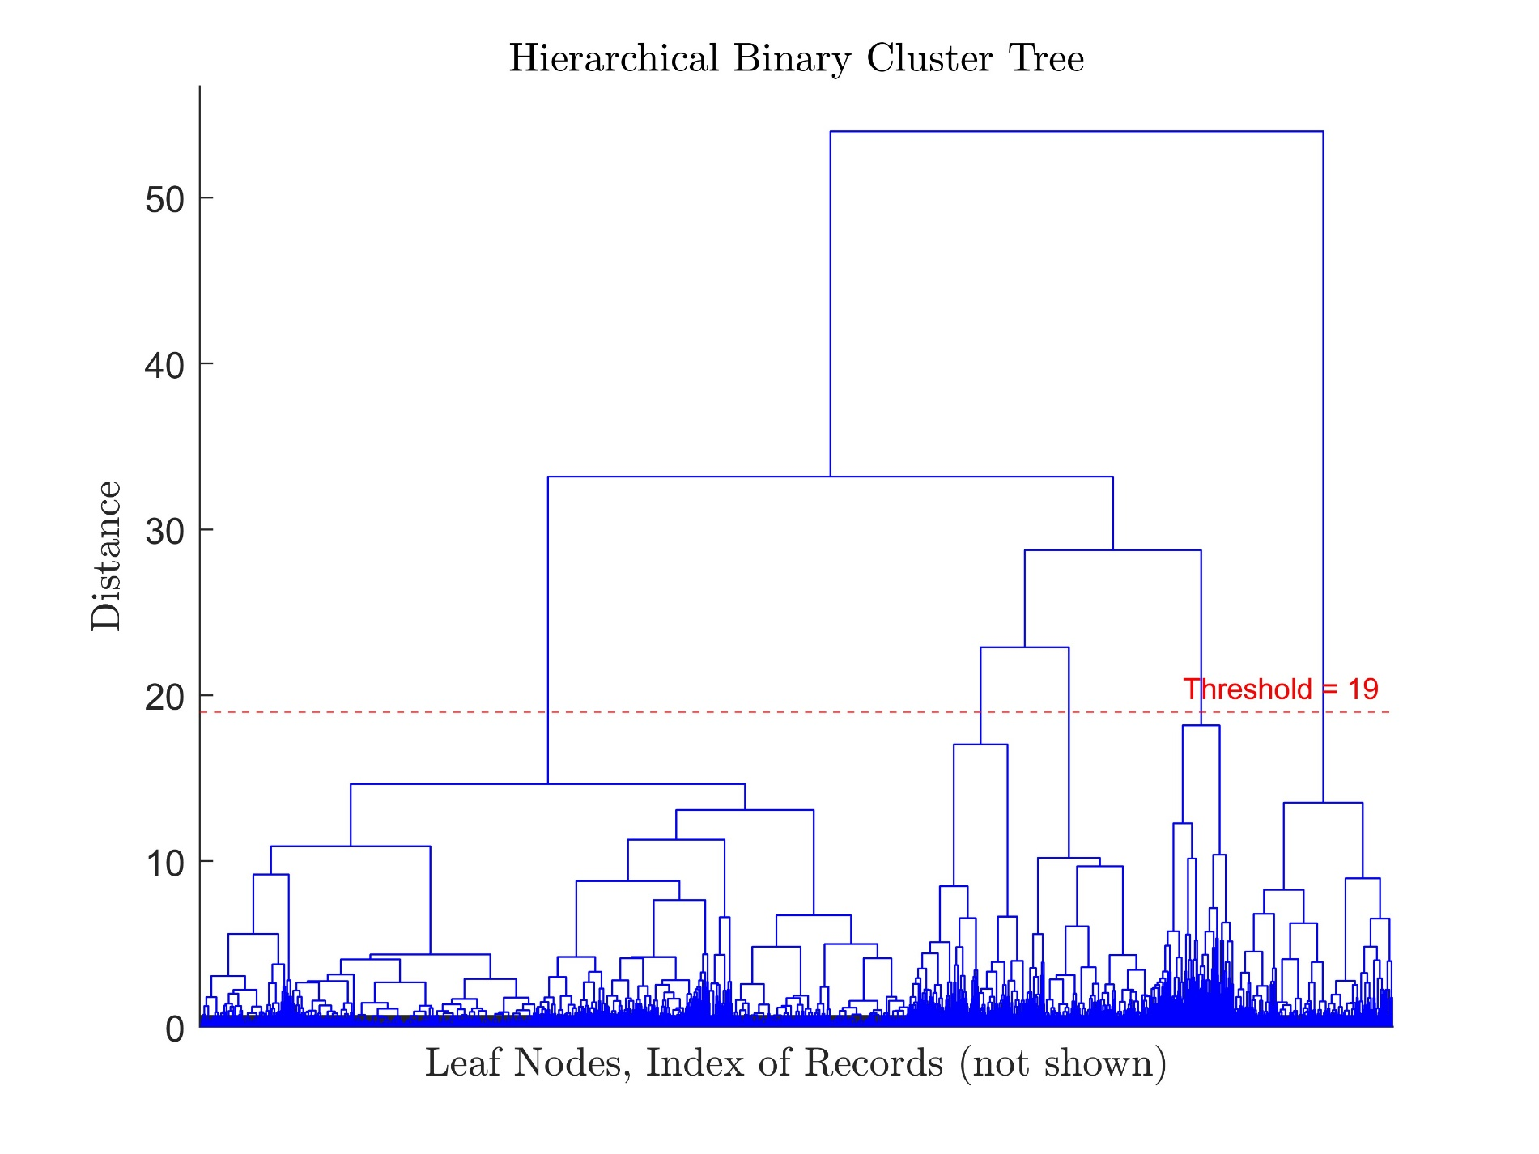
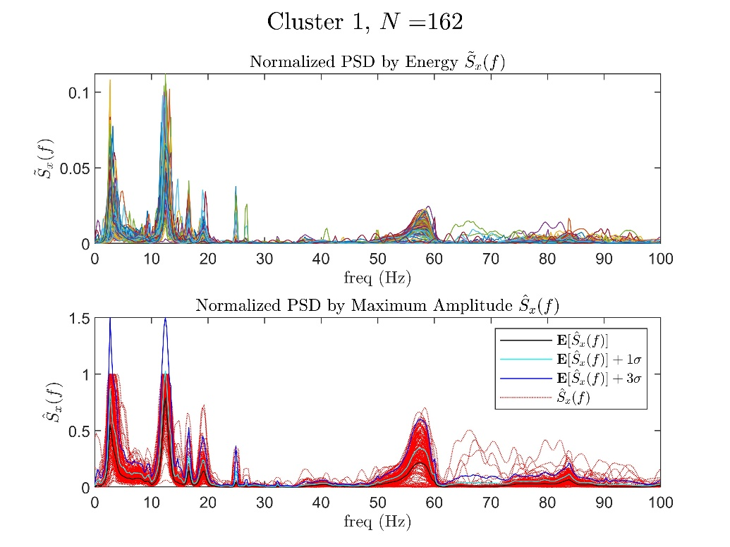
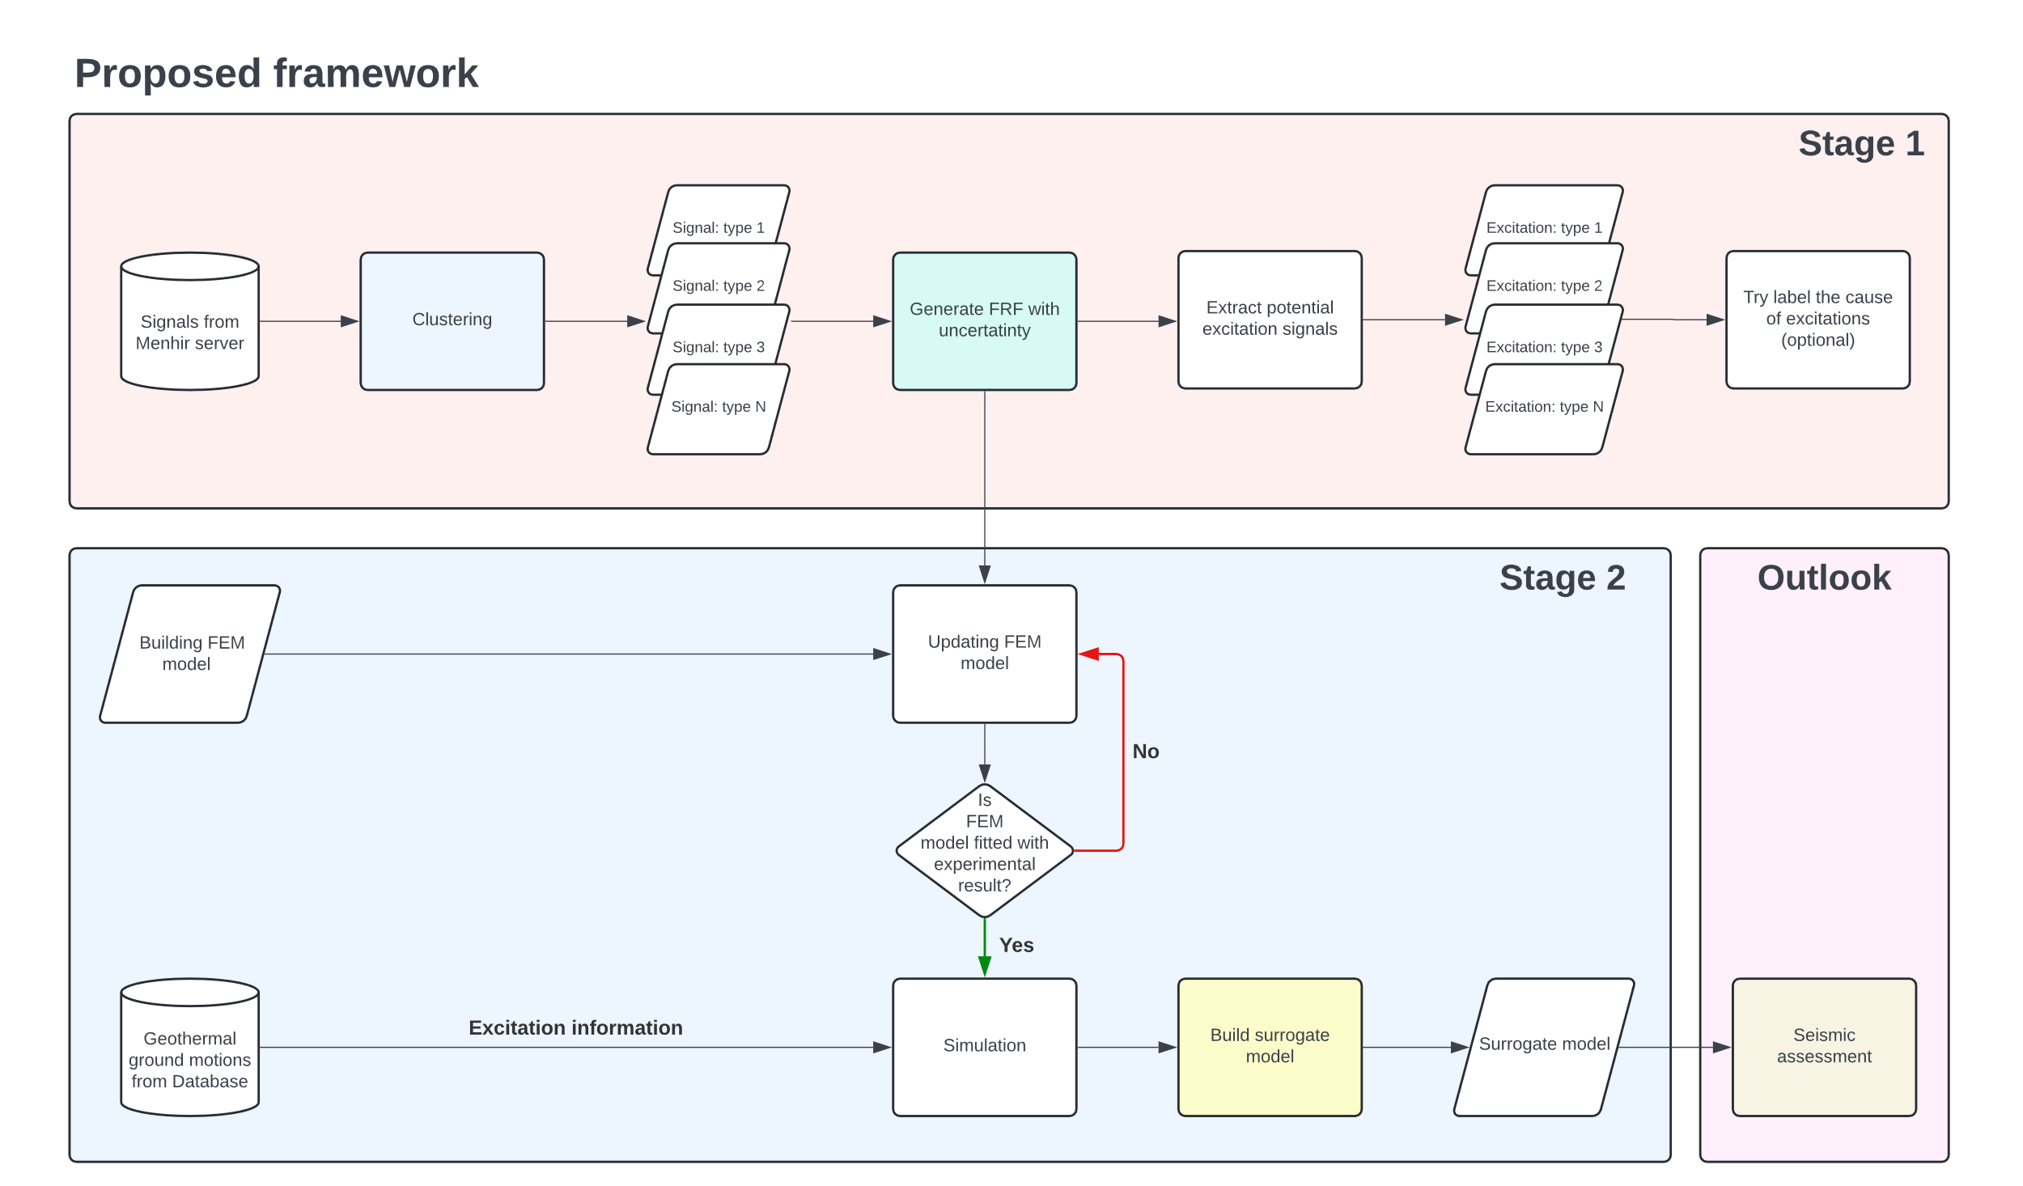
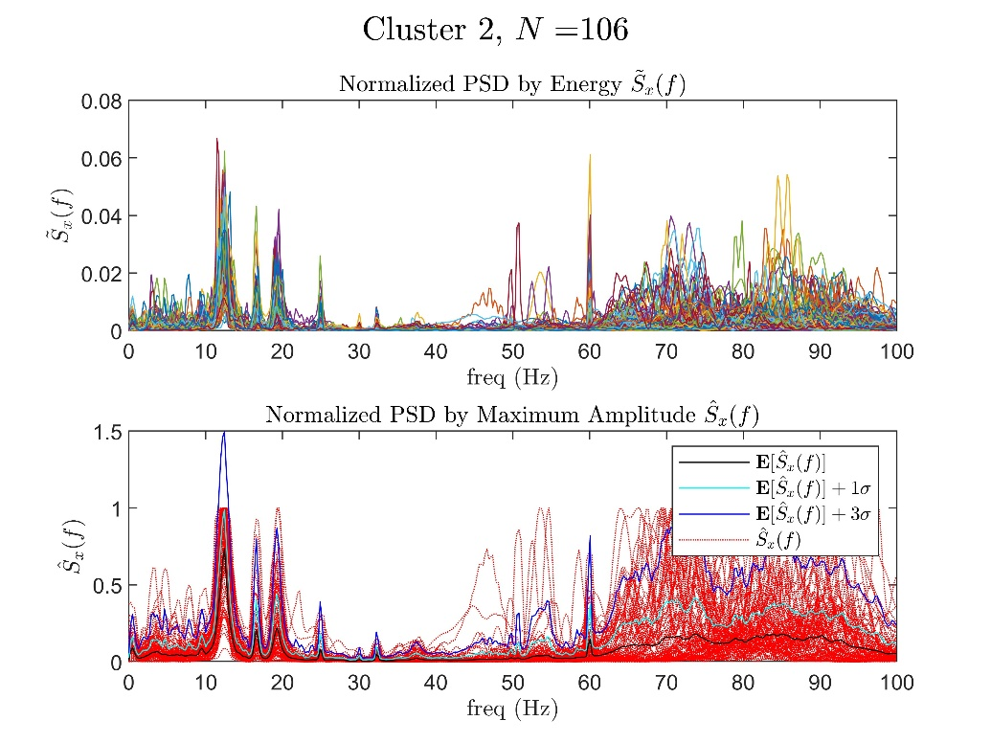
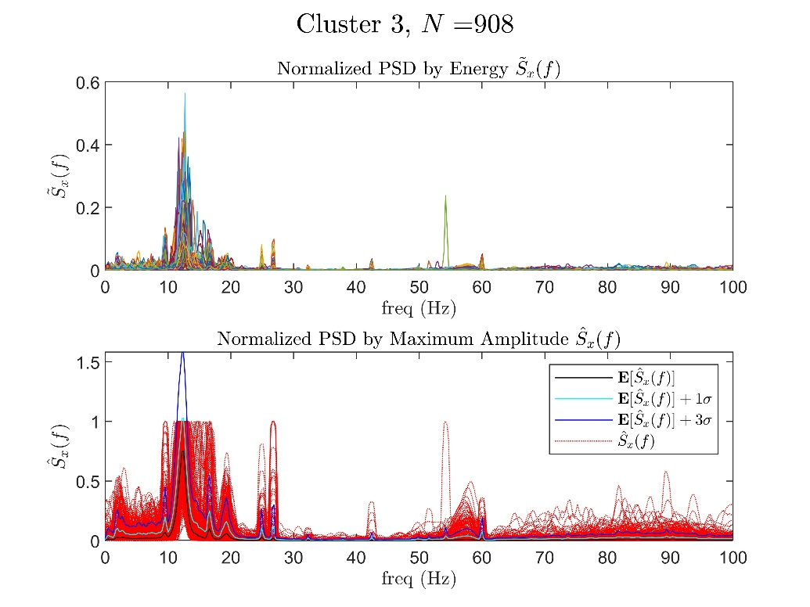
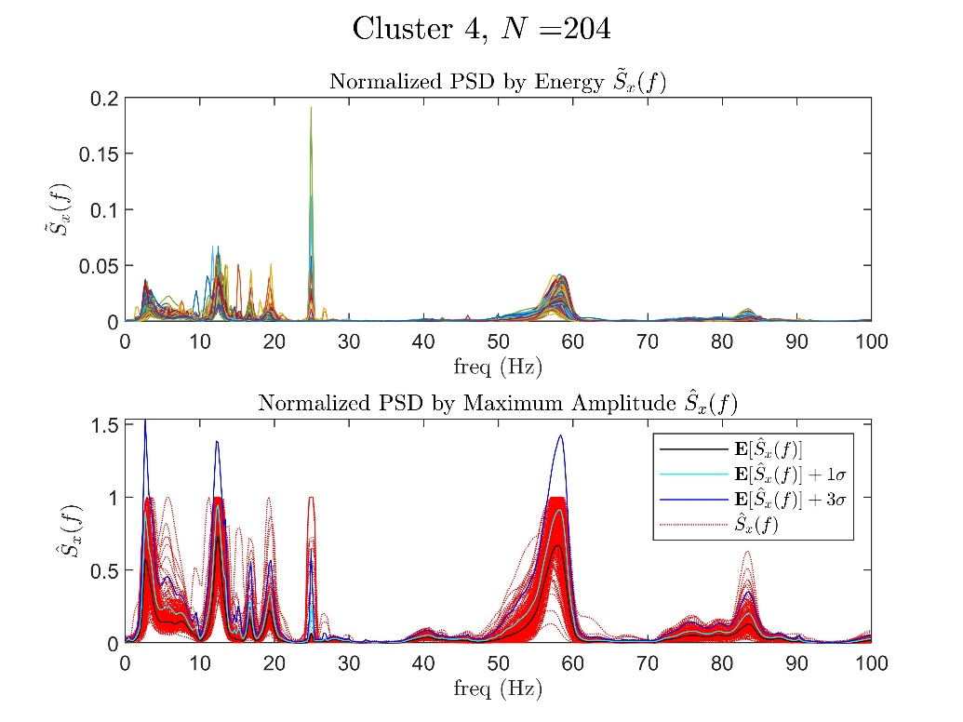
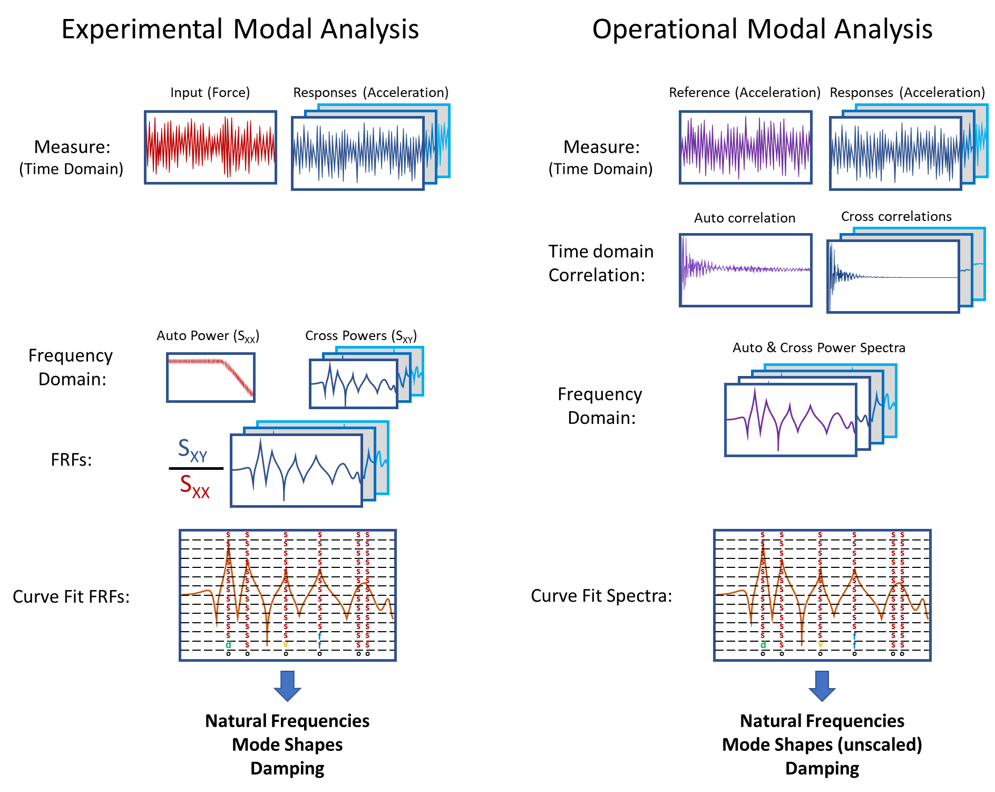
Enhancing Seismic Safety in Munich's Geothermal Energy Sector: Data-driven Model Updating for Building Vibrations under Induced Seismicity
Wei-Teng, Kao
Prof. Dr. Gerhard Müller (Chair of Structural Mechanics), Prof. Dr. Wolfgang Wall (Chair of Numerical Mechanics)
Abstract
With increasing concerns about non-renewable resources, geothermal energy is becoming increasingly important for heat and power generation. Germany has set a goal to obtain a significant share of its energy from renewable sources by 2050. Deep geothermal plants are expected to make a significant contribution to meeting heat demand. However, these plants cause micro-seismic events that affect the serviceability of buildings and human comfort [1]. Until now, the measurement of seismic activity in the Bavaria region relied on the free-field vibration sensor network. In a novel approach, additional sensors were recently installed on different levels of a low-rise building on the site of a geothermal plant in the south of Munich. This strategic sensor network aims to collect and analyze unique vibration data. The project focuses on improving the understanding and prediction of building responses to micro-earthquakes through data-driven model updating.
The first stage will involve processing and preparing existing sensor data using classical and modern machine learning approaches, such as unsupervised learning, for automatic data processing and feature extraction. The second stage will involve developing surrogate models to quantify uncertainty and replace detailed nonlinear analyses. These models will use experimental data to improve the prediction accuracy of structural behavior under induced seismicity. By improving existing building models using experimental data, this project aims to develop a prediction model to mitigate the effects of induced seismicity in geothermal plants. By monitoring building integrity under induced seismicity, the project will contribute to the safety and efficiency of geothermal operations in Munich and potentially worldwide (fig 1).
Overall Framework
To understand and predict the effect of micro-earthquake on buildings, the following framework is proposed (fig 2), which includes two stages. For this project, two databases are accessed; the first stores the sensor data from monitoring the vibration signals in the example building for over one year, and the second saves weak to moderated scaled geothermal-induced seismicity from seismic stations in the Insheim area, Germany.
Stage 1
In the first stages, The focus is on extracting the Frequency Response Functions (FRFs) or so-called Transfer Function (TF) and identifying the system of example building by analyzing the existing sensor data. The uncertainty of FRF will be quantified to better describe the building model. This process includes the following steps:
Clustering: Since the sensor data are unlabeled and the source of excitation is unknown, the clustering technique is utilized to characterize different response types based on their pattern of signals in the frequency domain. By analyzing each clustering, the outlier and the responses severely compromised by noise could be discarded priorly (fig 3).
Identify the system: The system of the building is commonly represented by the natural frequency, damping ratio, and the mode shapes of a structure. These parameters are significant for verifying accuracy and calibrating a finite element (FE) model. Practically, the building system can be identified using experimental modal analysis (EMA) or operational modal analysis (OMA) [2]. The difference between EMA and OMA is that EMA analyzes the system via measured force during the experiment, such as hammer impact and shaker. Conversely, OMA determines the system from operational vibration measurements, especially under real-world operational conditions (fig 4).
Forming the FRFs: FRFs represent the response of a system per unit excitation as a function of frequency. The experimental FRFs of the building can be extracted by measurement tests, such as impact and shaker testing (fig 5). To parameterize the FRFs, the Rational Fraction Polynomial method (RFP) or the Mode Superposition Method (MSUP) could be applied, which are based on classical or modern curve fitting procedures.
Fig 3, Clustering the recorded sensor data using the Hierarchical Clustering technique .
Fig 2, The proposed framework of the whole project
Fig 1, Schematic diagram of the project. By monitoring the vibration of the example building, the system of the building and the potential loading types can be identified. The behavior of such structure dynamics will be trained and predicted by the surrogate model built via the machine learning technique.
Fig 4, Comparison of two system identification techniques, EMA and OMA
(https://community.sw.siemens.com/s/article/OMG-What-is-OMA-Operating-Modal-Analysis) .
M.Sc. Wei-Teng Kao
TUM Chair of Structural Mechanic
Technical University of Munich Arcisstr. 21 80333 Munich
ge32gak@mytum.de
Prof. Dr. Gerhard Müller
TUM Chair of Structural Mechanic
Technical University of Munich Arcisstr. 21 80333 Munich
gerhard.mueller@tum.de
Prof. Dr. Wolfgang Wall
TUM of Numerical Mechanics
Technical University of Munich
Boltzmannstr. 15 85748 Garching b.
wolfgang.a.wall@tum.de
MDSI General Assembly, October 24, 2024

Slide 8
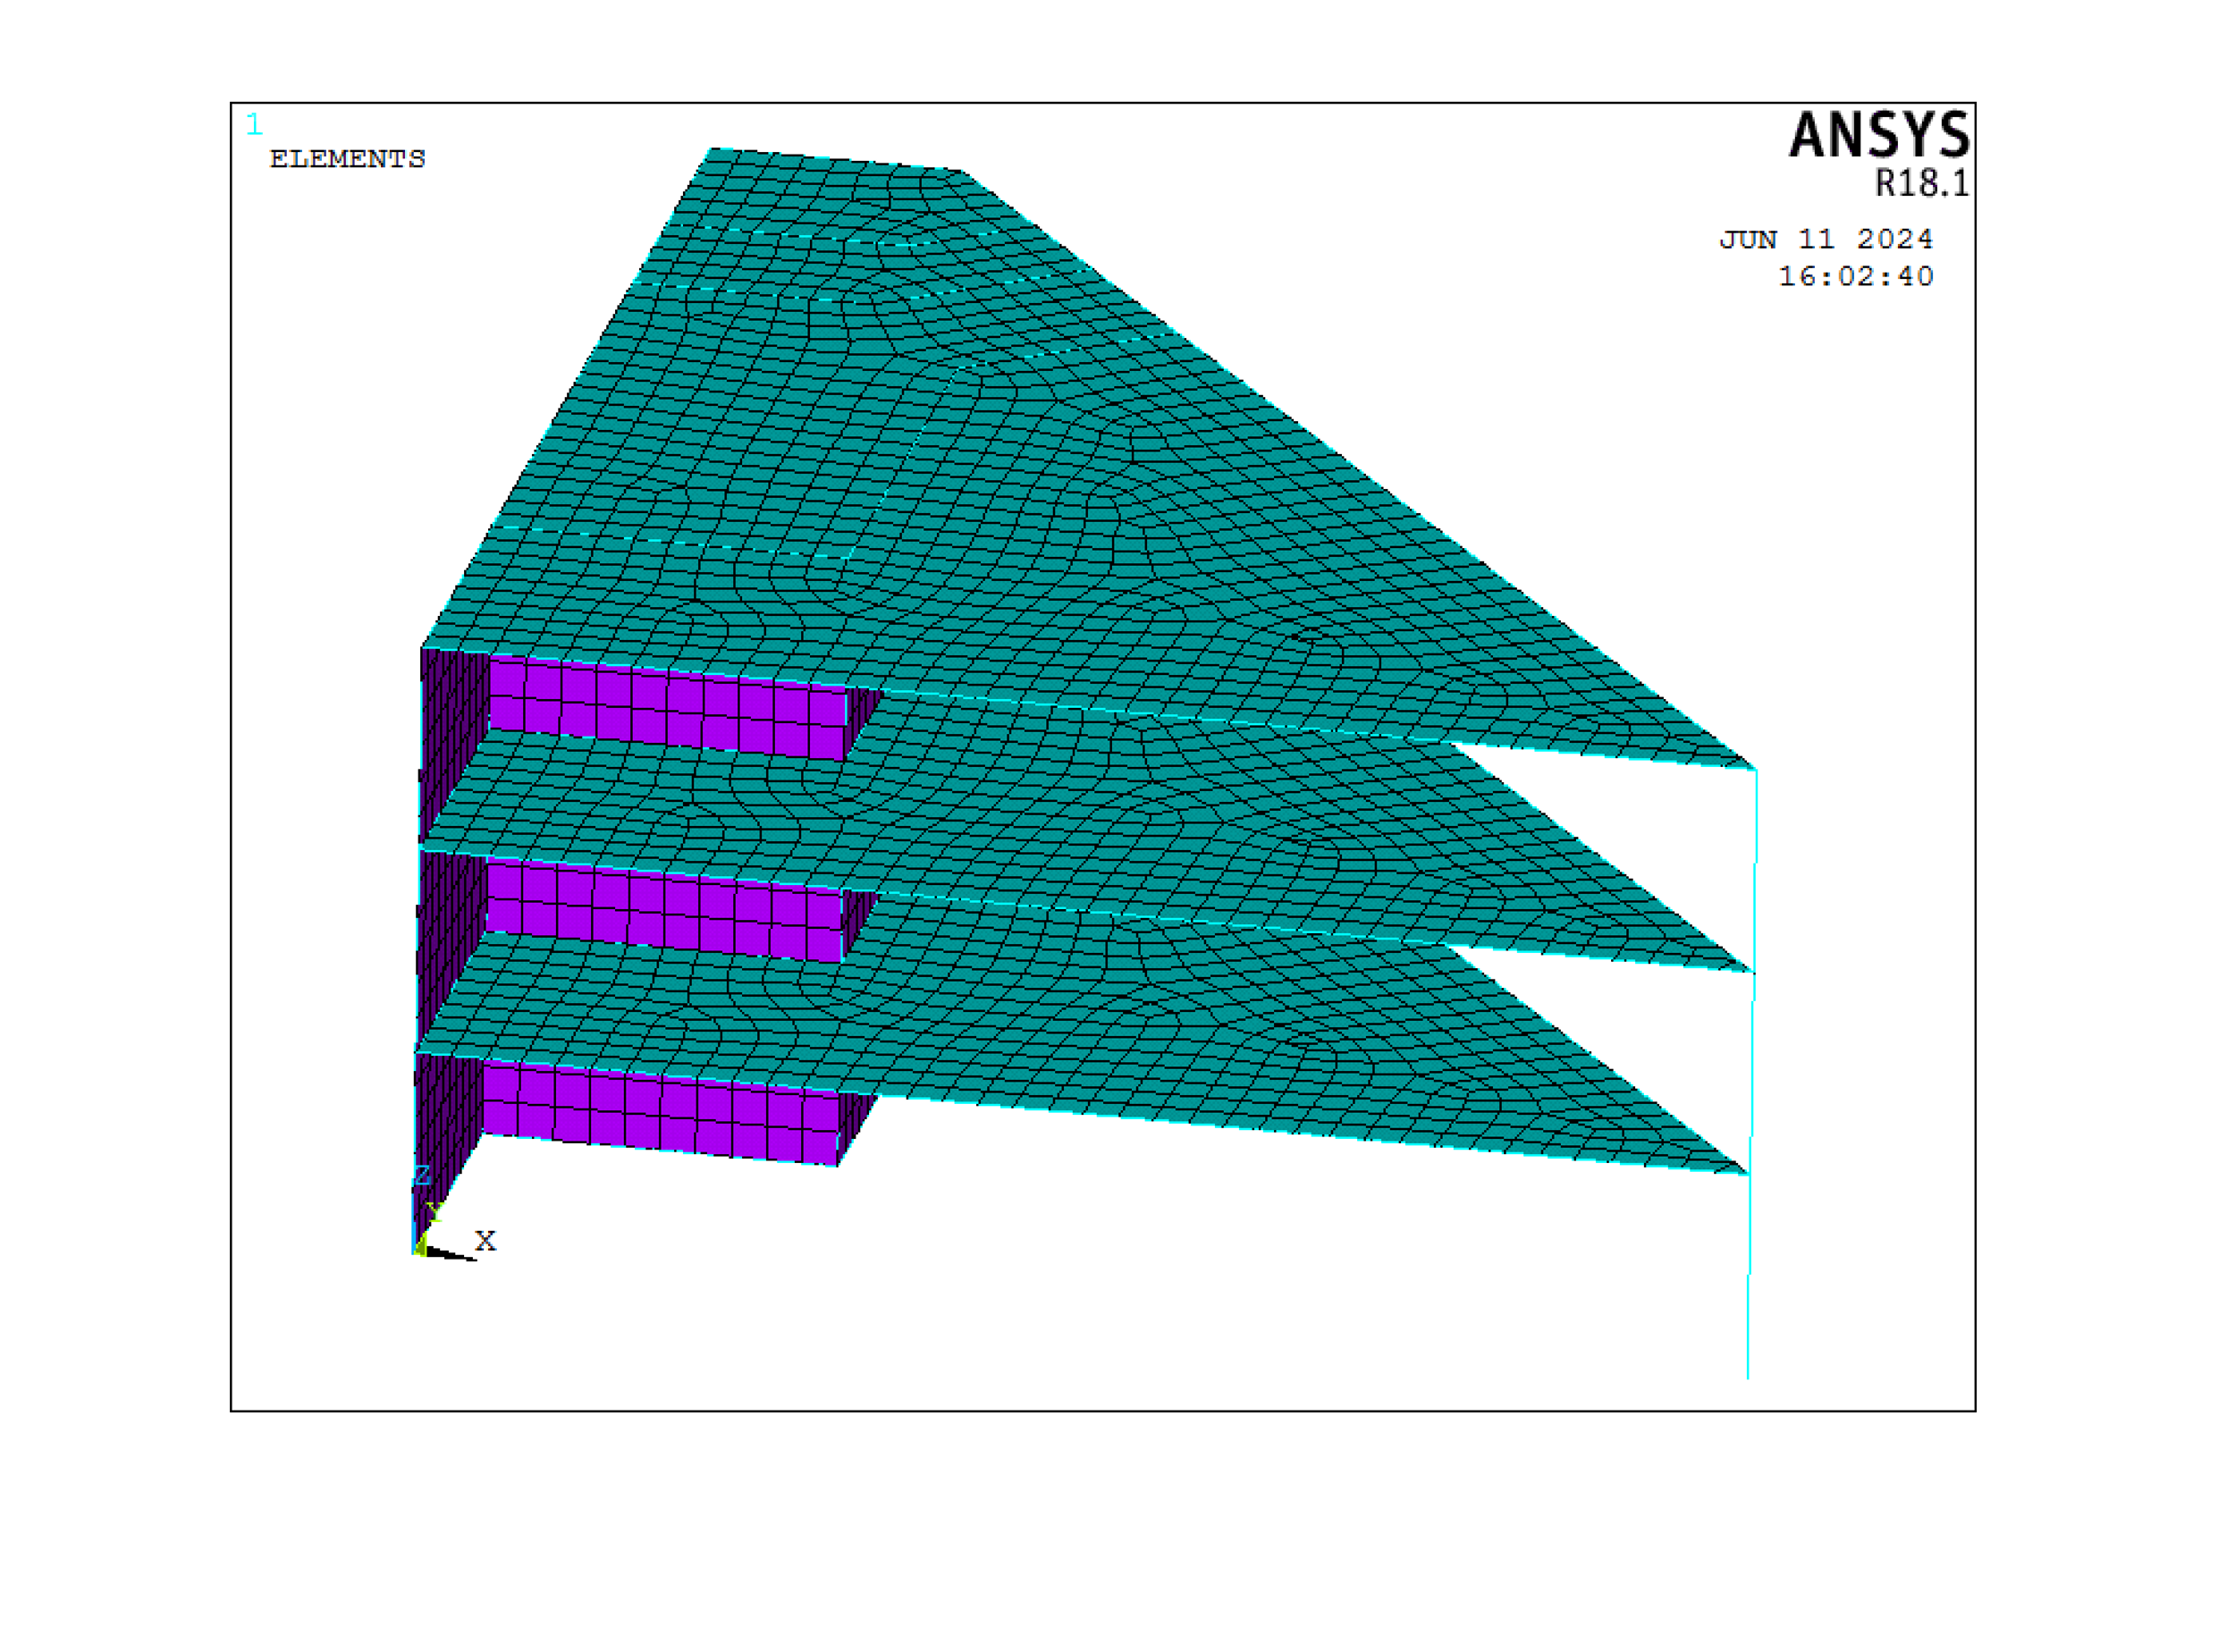
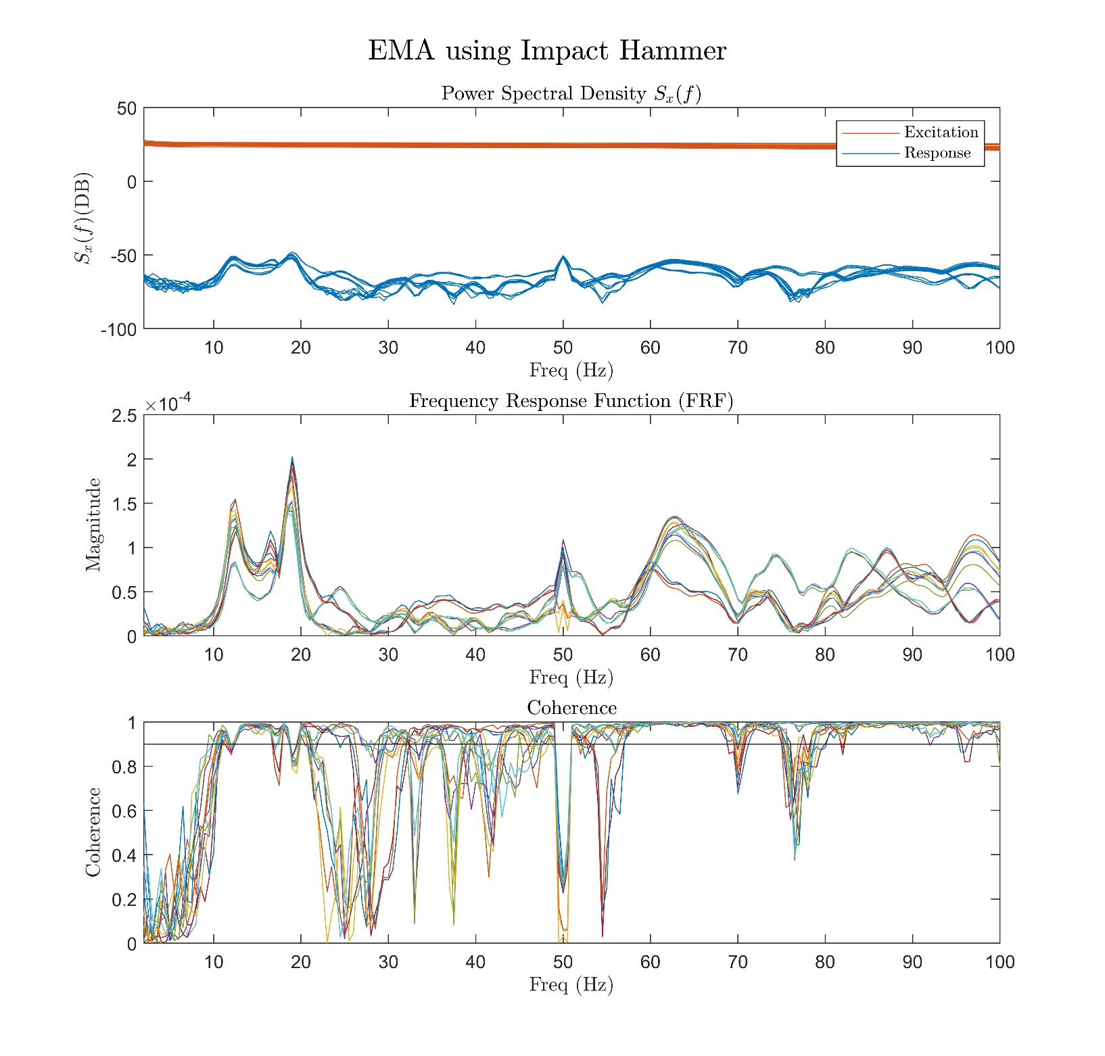
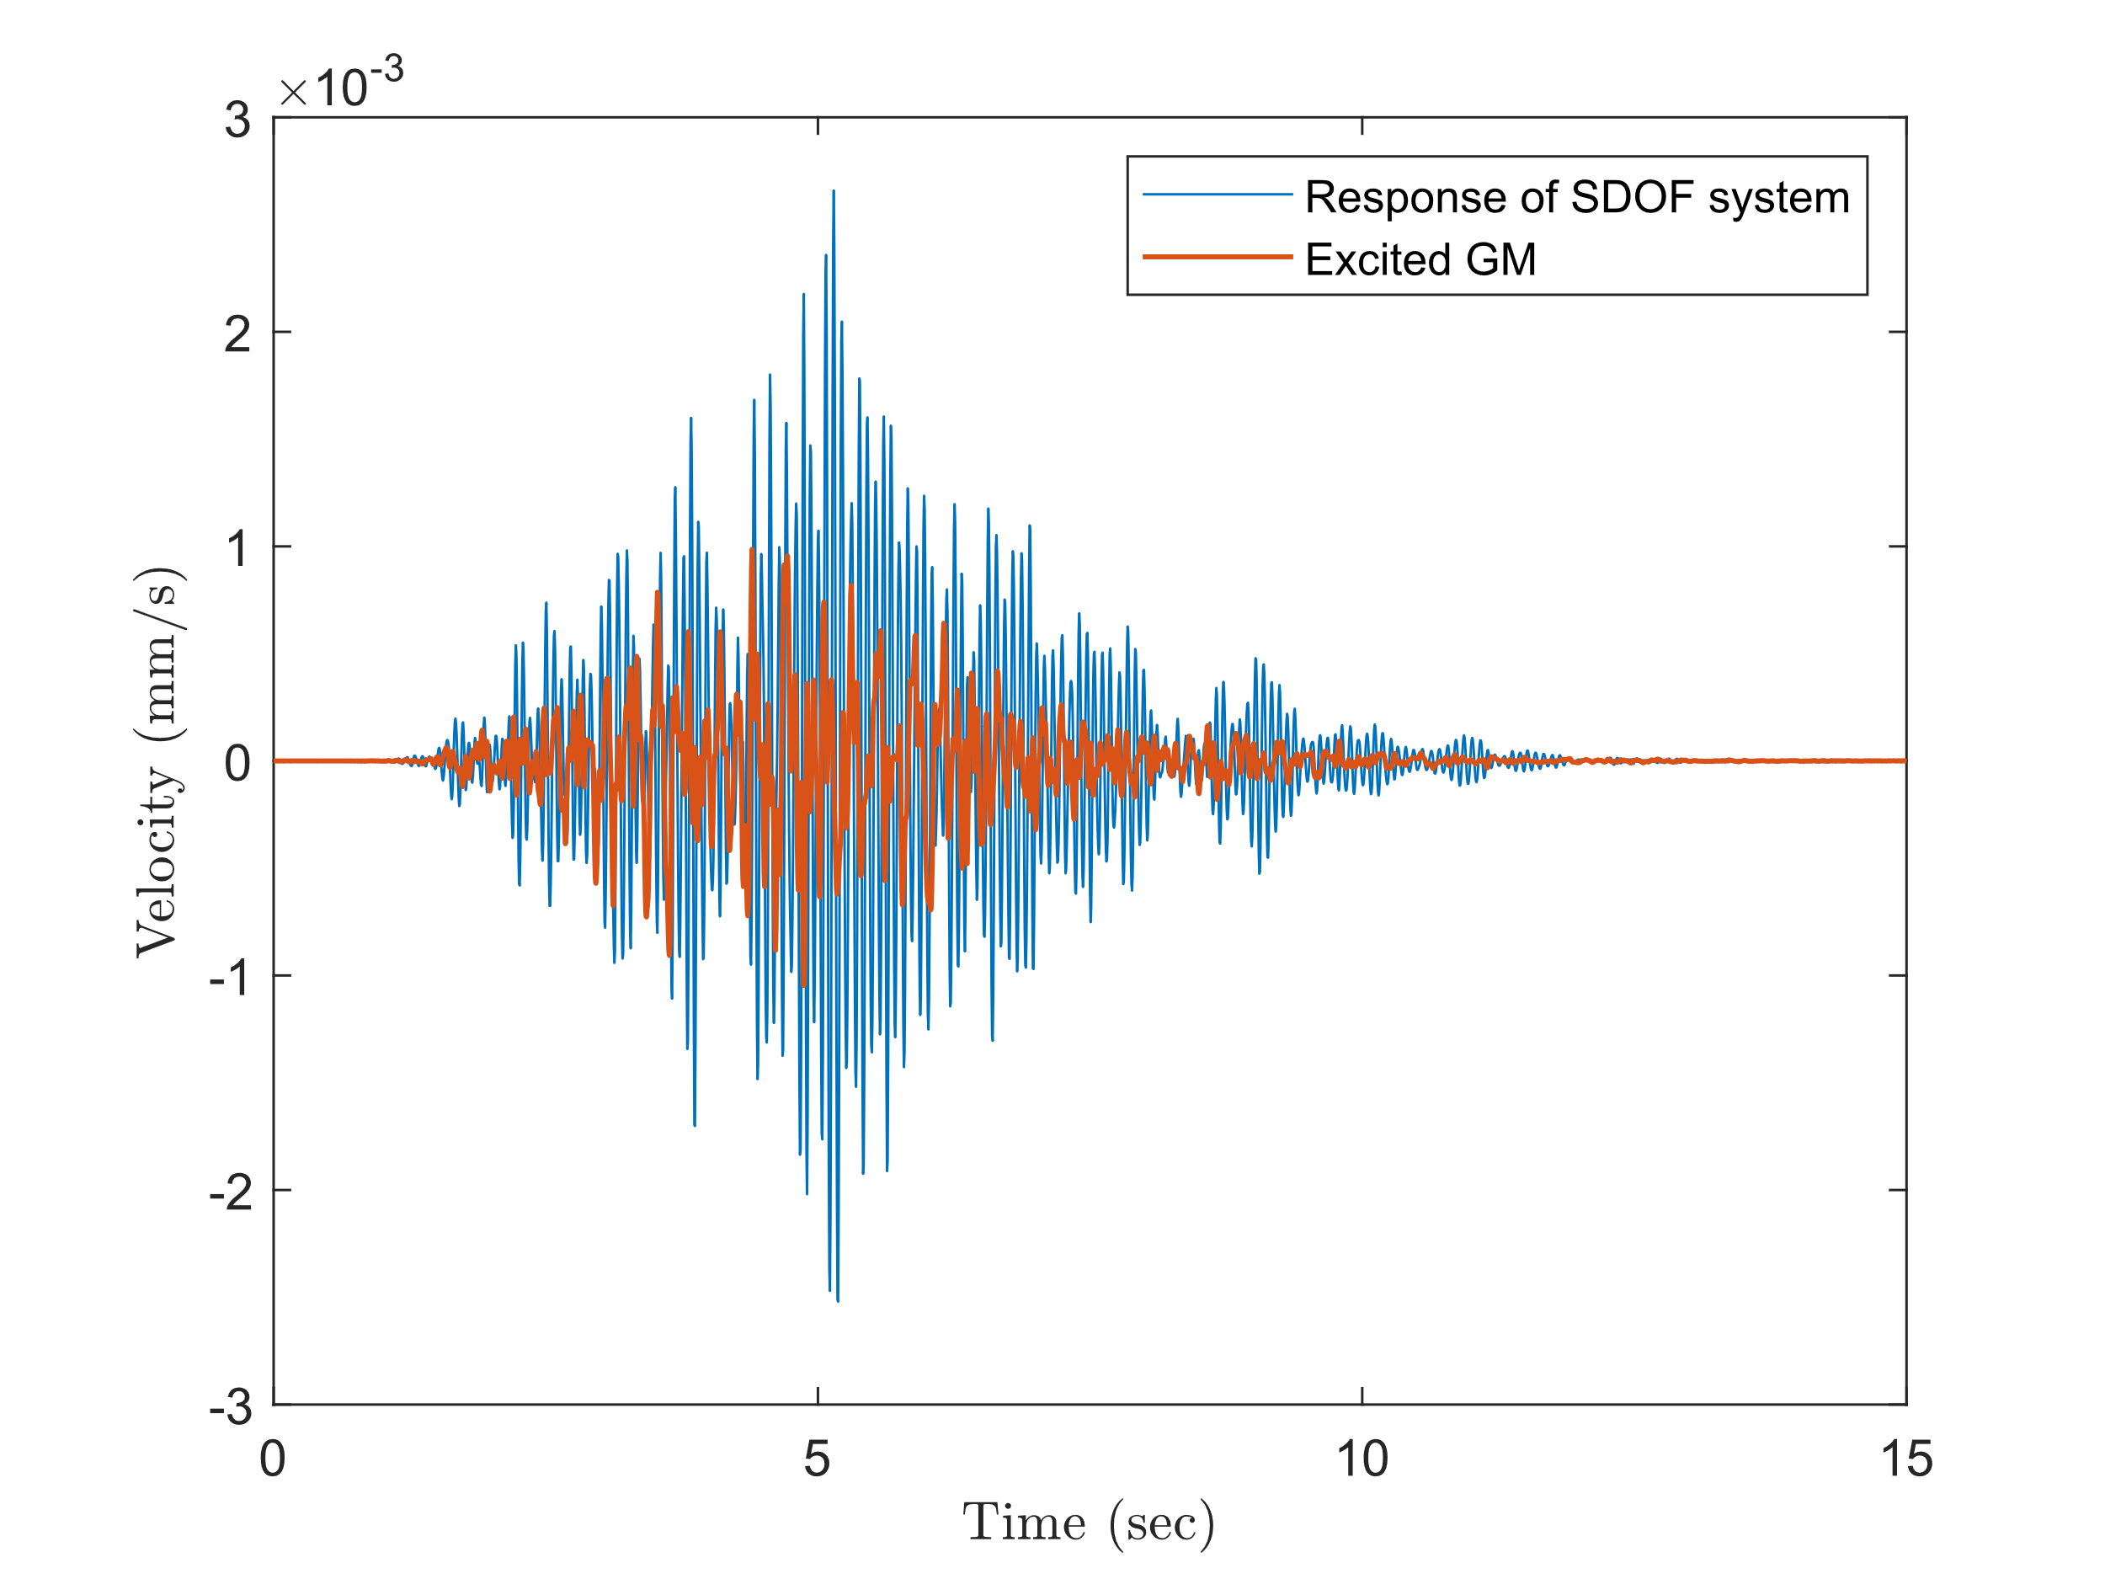

Enhancing Seismic Safety in Munich's Geothermal Energy Sector: Data-driven Model Updating for Building Vibrations under Induced Seismicity
Wei-Teng, Kao, Dr. Aditi Kumawat
Prof. Dr. Gerhard Müller (Chair of Structural Mechanics), Prof. Dr. Wolfgang Wall (Chair of Numerical Mechanics)
Infer the possible excitations: Once the FRFs are formed and the predominant natural frequency and damping ratio are identified, the possible excitation causing the vibration of the building from the first database will be inferred. Combined with the information from clustering in the prior process, a better understanding of the environment and the properties of the example building, such as the effect of different excitation types on structures and the characteristics of response in various frequency ranges, can be obtained.
Stage 2
The surrogate model is a model that can efficiently interpret the relationship between input and output behavior of complex systems. The surrogate model will be developed after the training data from Stage 1 are prepared. The following steps will accomplish this stage:
Building the FE model: The FE model transfers the real-world complex structure to the computational solvable model for the Finite Element Method (FEM). By defining the geometry of the building and the material properties of the structure, the mathematical building model (fig 6) will be built and ready for further analysis.
Updating the FE model: The result of FEM is commonly deterministic and depends on the parameters defined by the user. This implies that if the user provides inappropriate parameters for the model, then the following simulation might lead to an inaccurate result. To overcome this issue and improve the accuracy of the result, the parameters of the FE model are updated and validated by the system information identified in the first stage. This process is crucial to generate a representative FE model for precise results from simulation.
Simulation: To understand the influence of geothermal-induced earthquakes on the example building, the structure dynamic is simulated by Transient or Harmonic analysis using the commercial software ANSYS. The input loadings focused on by this project are the vibration signals of geothermal-induced earthquakes recorded from seismic stations. The result provides information on the building’s deformation, velocity, or any requested physical information under such excitation (fig 6).
Building the surrogate model: Simulation via FEM is time-consuming and computationally expensive. Some high-fidelity time-dependent simulations might take over 8 hours for only one event. To fulfill the goals of this project, which might require evaluating more than 1000 events, the techniques to accelerate or replace the costly simulation are necessary. Building a probability-based surrogate model helps us efficiently re-construct the relationship between input parameters and output results and considers the uncertainty (fig 7). This surrogate model can be built using advanced regression methods or machine learning techniques, such as Neural Networks (NN).
Outlook
This seed-fund project aims to construct an efficient model to represent the example building by combining existing sensor data, computational mechanics, and modern machine-learning techniques. This model could be used for further analysis, such as:
Global sensitivity analysis (GSA): The GSA provides information about the significance of each designed parameter. With this technique, researchers can better understand which parameter of the building might have caused the largest impact on the structure under earthquakes.
Serviceability analysis: This assessment analyzes a structure’s ability to remain functional and comfortable for its occupants during normal usage without exceeding certain limits on factors like deflection, vibration, and cracking.
Comfortability analysis: Comfortability analysis for buildings evaluated the influence of the comfort and well-being of the occupants within the built environment.
Reference
FE Model
Update model
https://www.tiefegeothermie.de/news/ertuechtigung-der-geothermiebohrungen-taufkirchen
Simulation
Fig 6, Building the FE model and perform the simulation to understand the structure dynamics of the example building under excitation [3].
Fig 5, FRFs obtained by hammer testing using EMA technique, N = 13 (left), and the mean FRF with the 95% confidence range (right)
Fig 7, Schematic diagram of building surrogate model. With the help of the surrogate model, the researcher can compute the representative result for the problem without time-consumed simulation and accelerate the process of further risk assessment [4] .
[1] Küperkoch, L ; Olbert, K ; Meier, T: Long-term monitoring of induced seismicity at the Insheim geothermal site, Germany. In: Bulletin of the Seismological Society of America 108 (2018), Nr. 6, p. 3668–3683.
[2] Orlowitz, E., & Brandt, A. (2017). Comparison of experimental and operational modal analysis on a laboratory test plate. Measurement, 102, 121-130.
[3] Kao, W.T. (2024). Integrated Parameter Study and Serviceability Assessment of Building Structures under Geothermally Induced Seismicity using Stochastic Polynomial Chaos Expansion [Unpublished master's thesis]. Technical University of Munich.
[4] Zou, J., Welch, D. P., Zsarnoczay, A., Taflanidis, A., & Deierlein, G. G. (2020). Surrogate Modeling for the Seismic Response Estimation of Residential Wood Frame Structures.
M.Sc. Wei-Teng Kao
TUM Chair of Structural Mechanic
Technical University of Munich Arcisstr. 21 80333 Munich
ge32gak@mytum.de
Prof. Dr. Gerhard Müller
TUM Chair of Structural Mechanic
Technical University of Munich Arcisstr. 21 80333 Munich
gerhard.mueller@tum.de
Prof. Dr. Wolfgang Wall
TUM of Numerical Mechanics
Technical University of Munich
Boltzmannstr. 15 85748 Garching b.
wolfgang.a.wall@tum.de
MDSI General Assembly, October 24, 2024

Slide 9
Thank you for your attention!
M.Sc. Wei-Teng Kao
TUM Chair of Structural Mechanic
Technical University of Munich Arcisstr. 21 80333 Munich
ge32gak@mytum.de
Prof. Dr. Gerhard Müller
TUM Chair of Structural Mechanic
Technical University of Munich Arcisstr. 21 80333 Munich
gerhard.mueller@tum.de
Prof. Dr. Wolfgang Wall
TUM of Numerical Mechanics
Technical University of Munich
Boltzmannstr. 15 85748 Garching b.
wolfgang.a.wall@tum.de
MDSI General Assembly, October 24, 2024

Slide 10
Enhancing Seismic Safety in Munich's Geothermal Energy Sector: Data-driven Model Updating for Building Vibrations under Induced Seismicity
Wie-Teng, Kao
Prof. Dr. Gerhard Müller (Chair of Structural Mechanics), Prof. Dr. Wolfgang Wall (Chair of Numerical Mechanics)
Stage 1:
Processing and preparing existing sensor data.
13 recorded data by the Experimental hammer testing (12.03.2024).
More than 1000 recorded data stored in the Menhir database from long-term monitoring (over one year).
For Menhir data, only output signals are stored, no information about excitation.
Clustering -> Processing the data in each cluster -> System identification -> FRFs with uncertainty.
Stage 2:
Simulation and Surrogate model.
A Geothermal-induced earthquake database from the Insheim area (or Munich) is required.
Updated FEM model by the information obtained by system identification in the first stage.
Perform simulation and generate the response under Geothermal-induced earthquake.
Training the surrogate model.
M.Sc. Wei-Teng Kao
TUM Chair of Structural Mechanic
Technical University of Munich Arcisstr. 21 80333 Munich
ge32gak@mytum.de
Prof. Dr. Gerhard Müller
TUM Chair of Structural Mechanic
Technical University of Munich Arcisstr. 21 80333 Munich
gerhard.mueller@tum.de
Prof. Dr. Wolfgang Wall
TUM of Numerical Mechanics
Technical University of Munich
Boltzmannstr. 15 85748 Garching b.
wolfgang.a.wall@tum.de
MDSI General Assembly, October 24, 2024

Slide 11
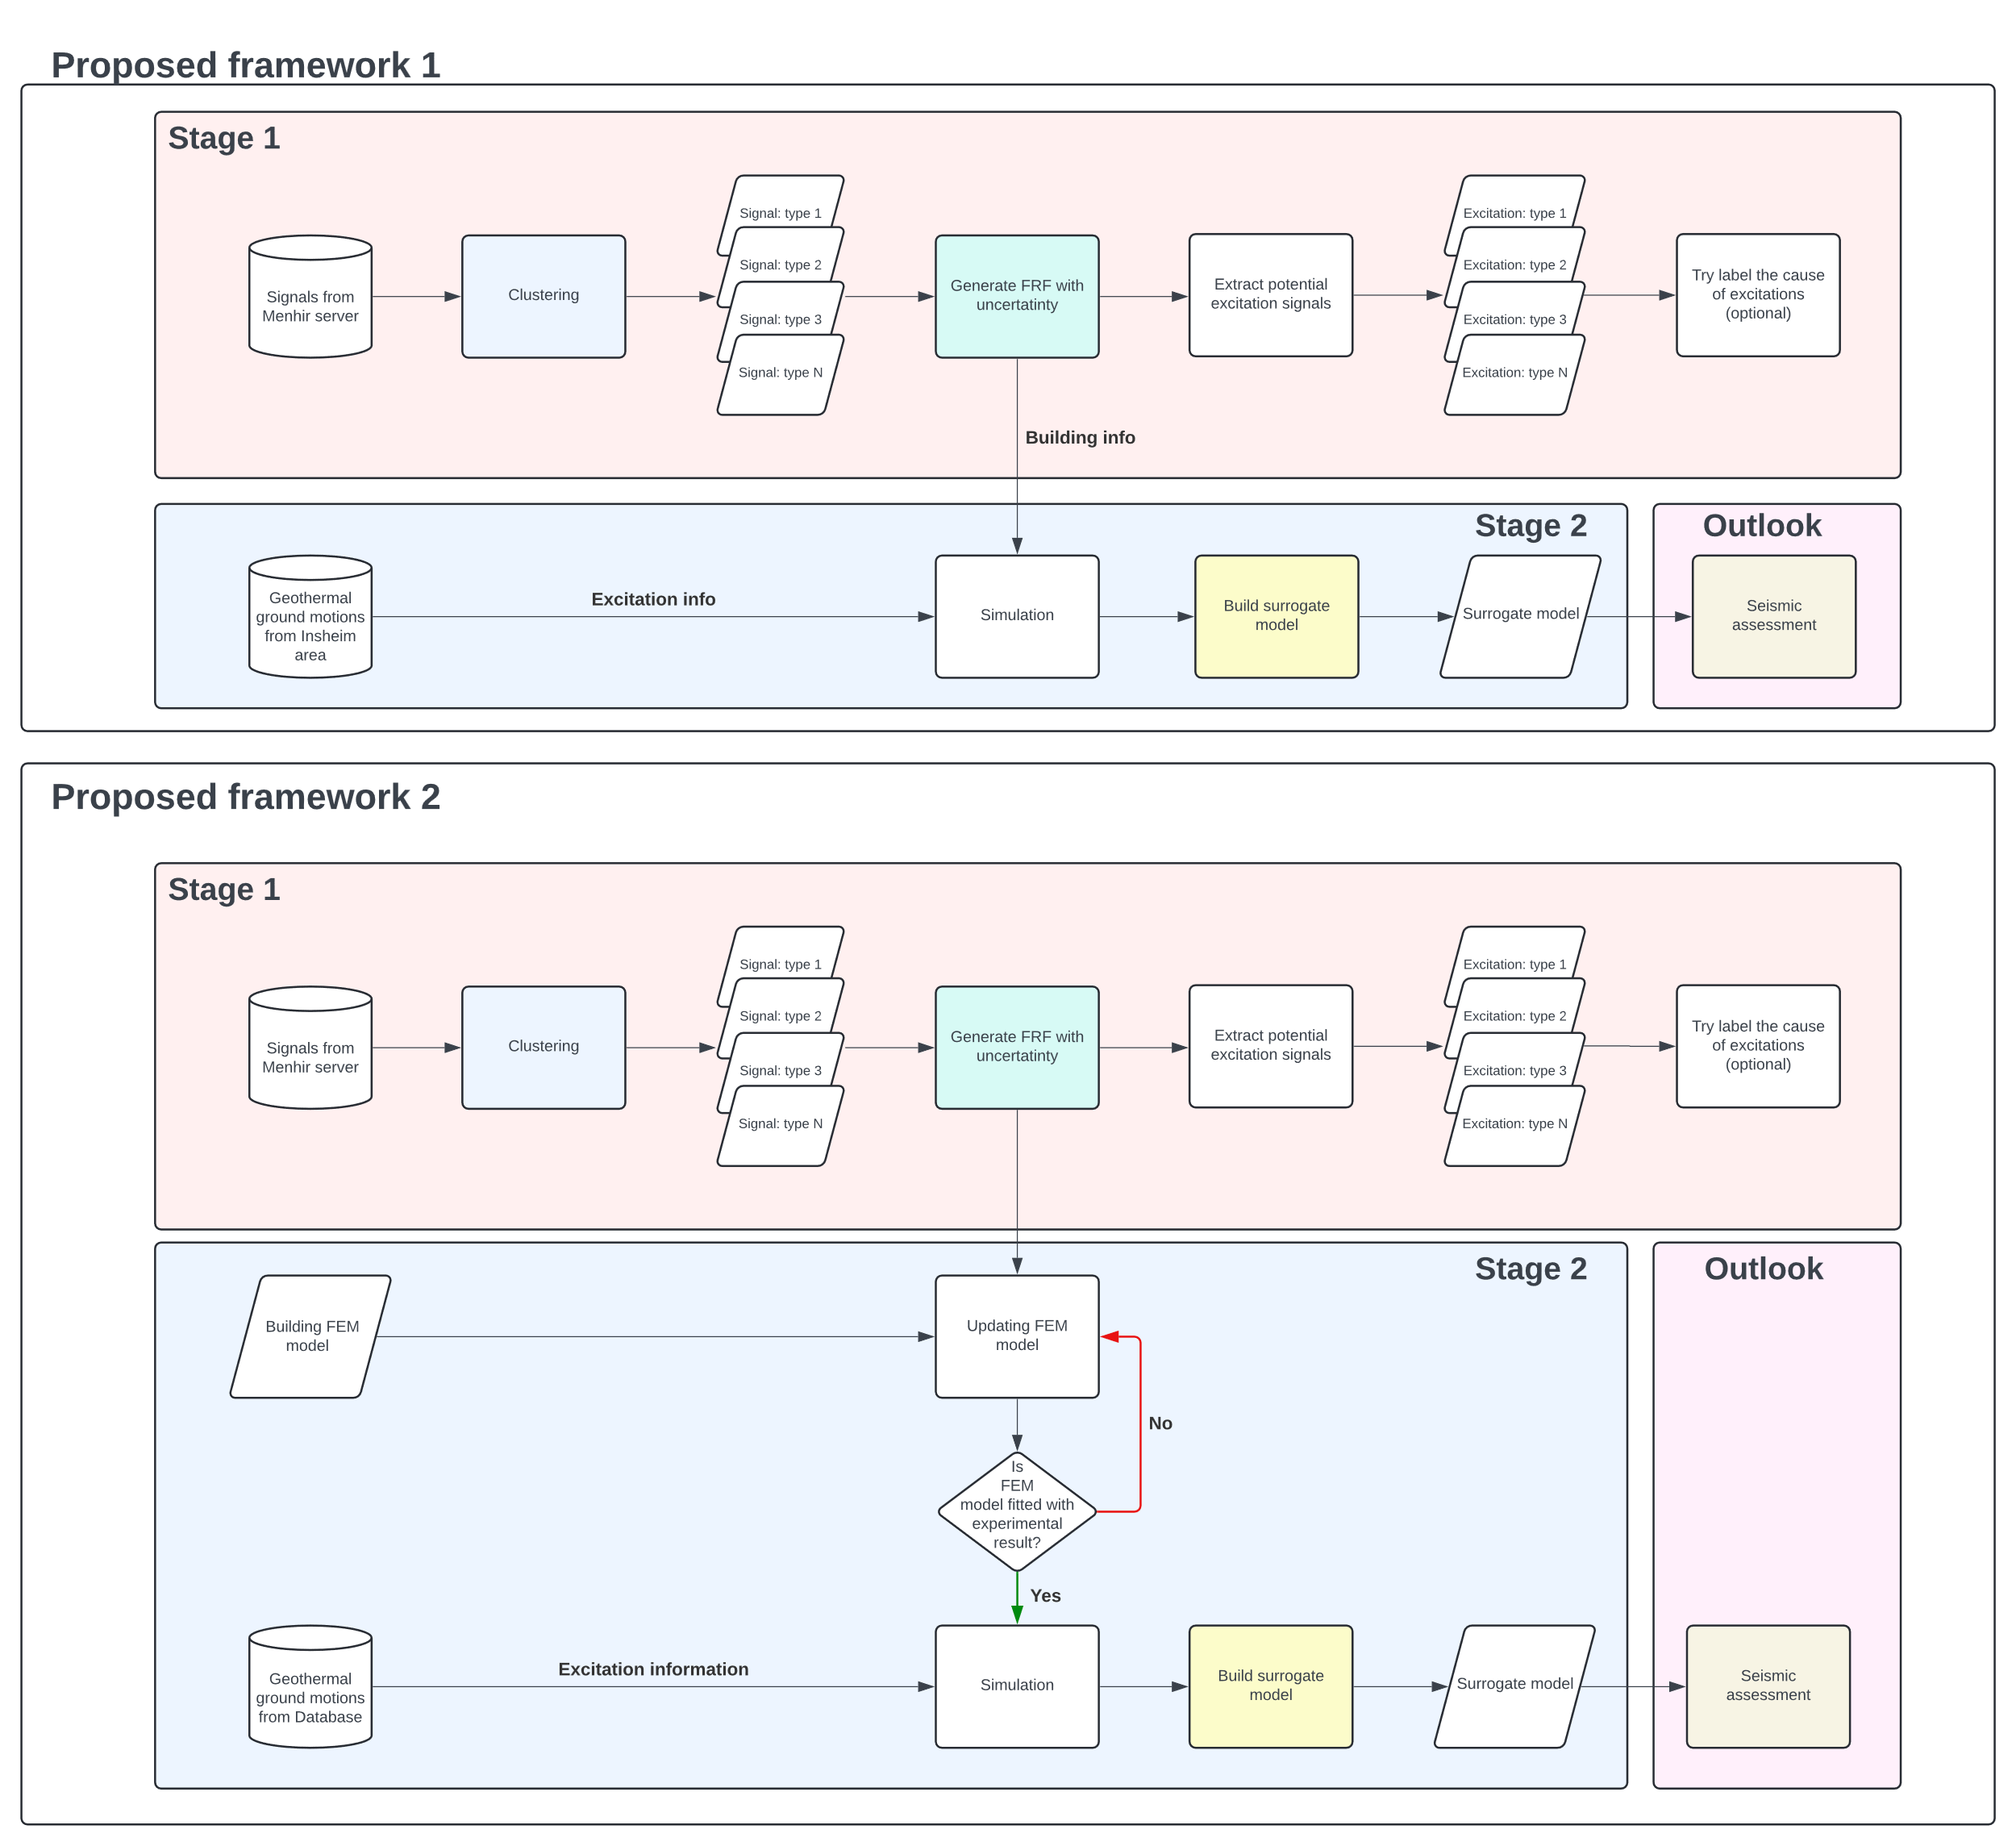
Enhancing Seismic Safety in Munich's Geothermal Energy Sector: Data-driven Model Updating for Building Vibrations under Induced Seismicity
Wie-Teng, Kao
Prof. Dr. Gerhard Müller (Chair of Structural Mechanics), Prof. Dr. Wolfgang Wall (Chair of Numerical Mechanics)
Currently, there are two proposals. However, the details still need to be discussed.
The difference between these two proposals is the system for the simulation part at stage 2
M.Sc. Wei-Teng Kao
TUM Chair of Structural Mechanic
Technical University of Munich Arcisstr. 21 80333 Munich
ge32gak@mytum.de
Prof. Dr. Gerhard Müller
TUM Chair of Structural Mechanic
Technical University of Munich Arcisstr. 21 80333 Munich
gerhard.mueller@tum.de
Prof. Dr. Wolfgang Wall
TUM of Numerical Mechanics
Technical University of Munich
Boltzmannstr. 15 85748 Garching b.
wolfgang.a.wall@tum.de
MDSI General Assembly, October 24, 2024

Slide 12
Enhancing Seismic Safety in Munich's Geothermal Energy Sector: Data-driven Model Updating for Building Vibrations under Induced Seismicity
Wei-Teng, Kao
Prof. Dr. Gerhard Müller (Chair of Structural Mechanics), Prof. Dr. Wolfgang Wall (Chair of Numerical Mechanics)
M.Sc. Wei-Teng Kao
TUM Chair of Structural Mechanic
Technical University of Munich Arcisstr. 21 80333 Munich
ge32gak@mytum.de
Prof. Dr. Gerhard Müller
TUM Chair of Structural Mechanic
Technical University of Munich Arcisstr. 21 80333 Munich
gerhard.mueller@tum.de
Prof. Dr. Wolfgang Wall
TUM of Numerical Mechanics
Technical University of Munich
Boltzmannstr. 15 85748 Garching b.
wolfgang.a.wall@tum.de
MDSI General Assembly, October 24, 2024

